Slide 1
Building a bridge between business &
data science using Explainable AI

Slide 2

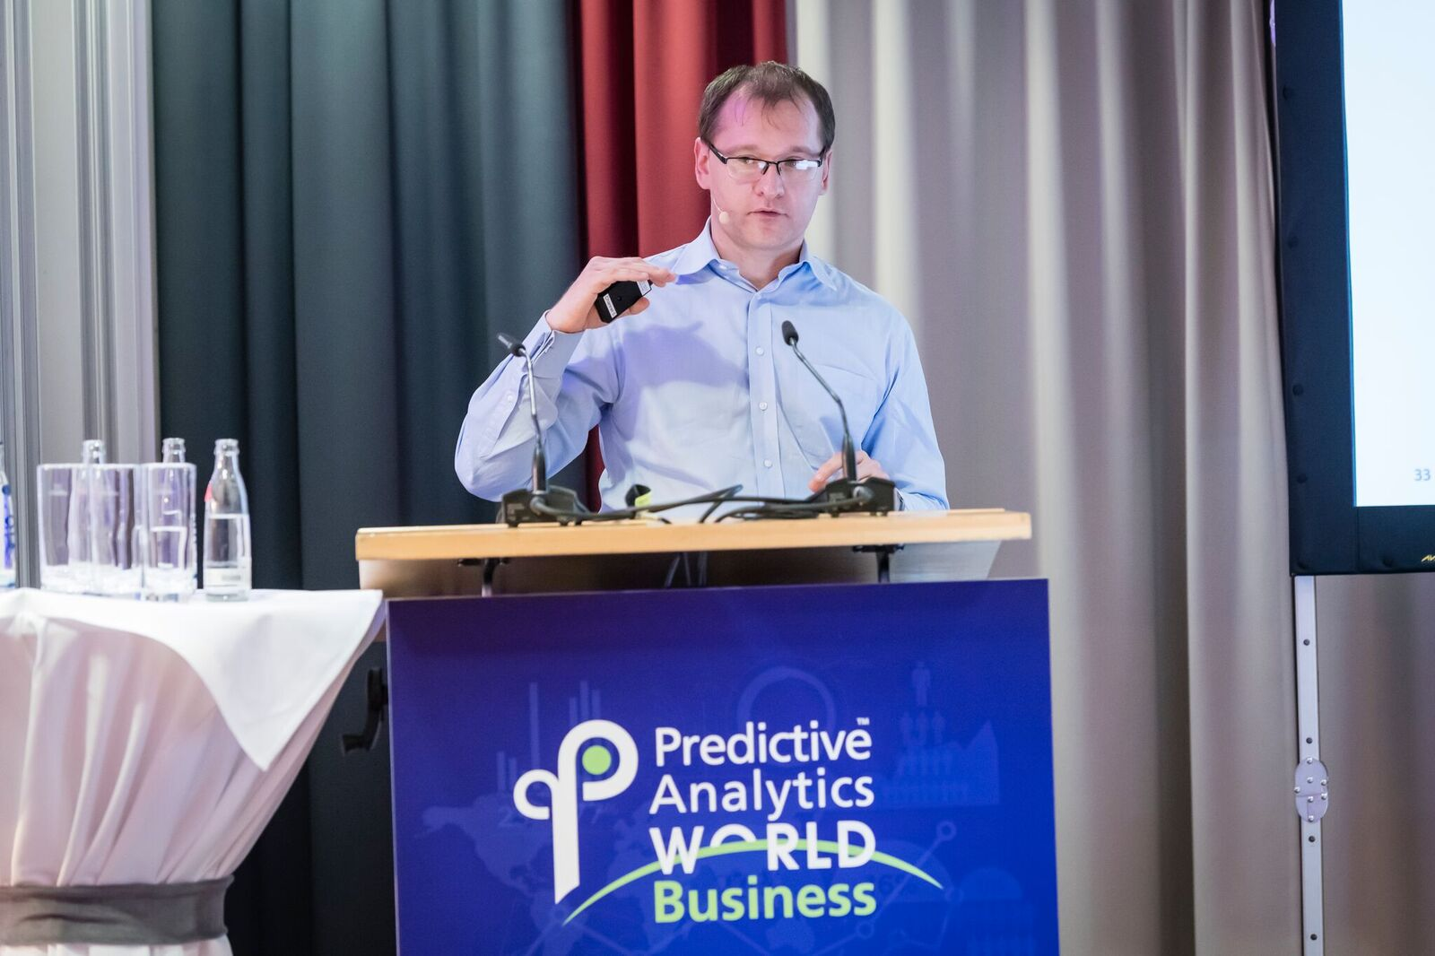
Schwarz group
Company introduction

Slide 3
Agenda
01
What is Explainable AI and why we need it.
02
Emerging approaches.
03
Application to retail use cases.
04
Future prospects.

Slide 4
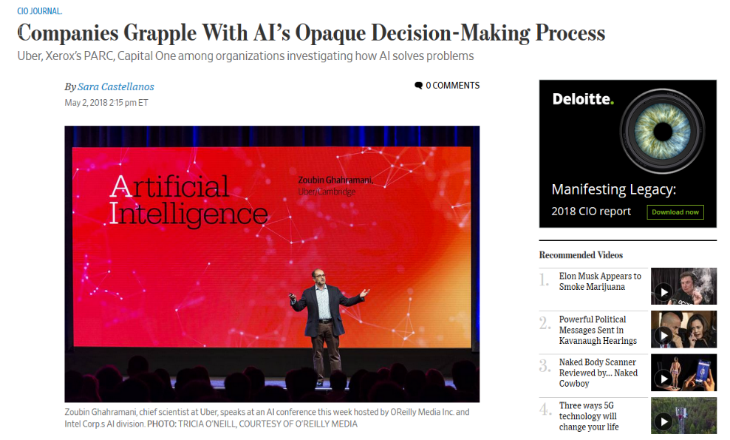
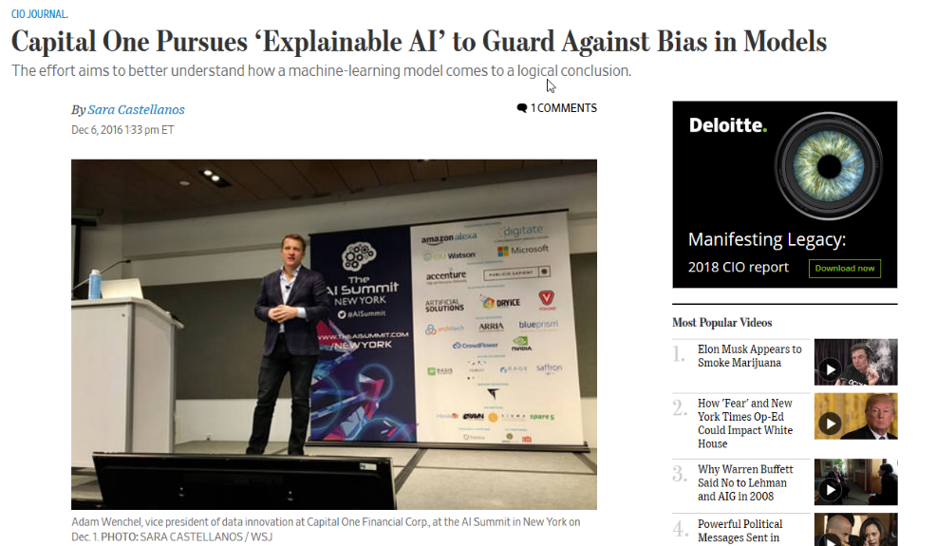
XAI in the media
Introduction

Slide 5
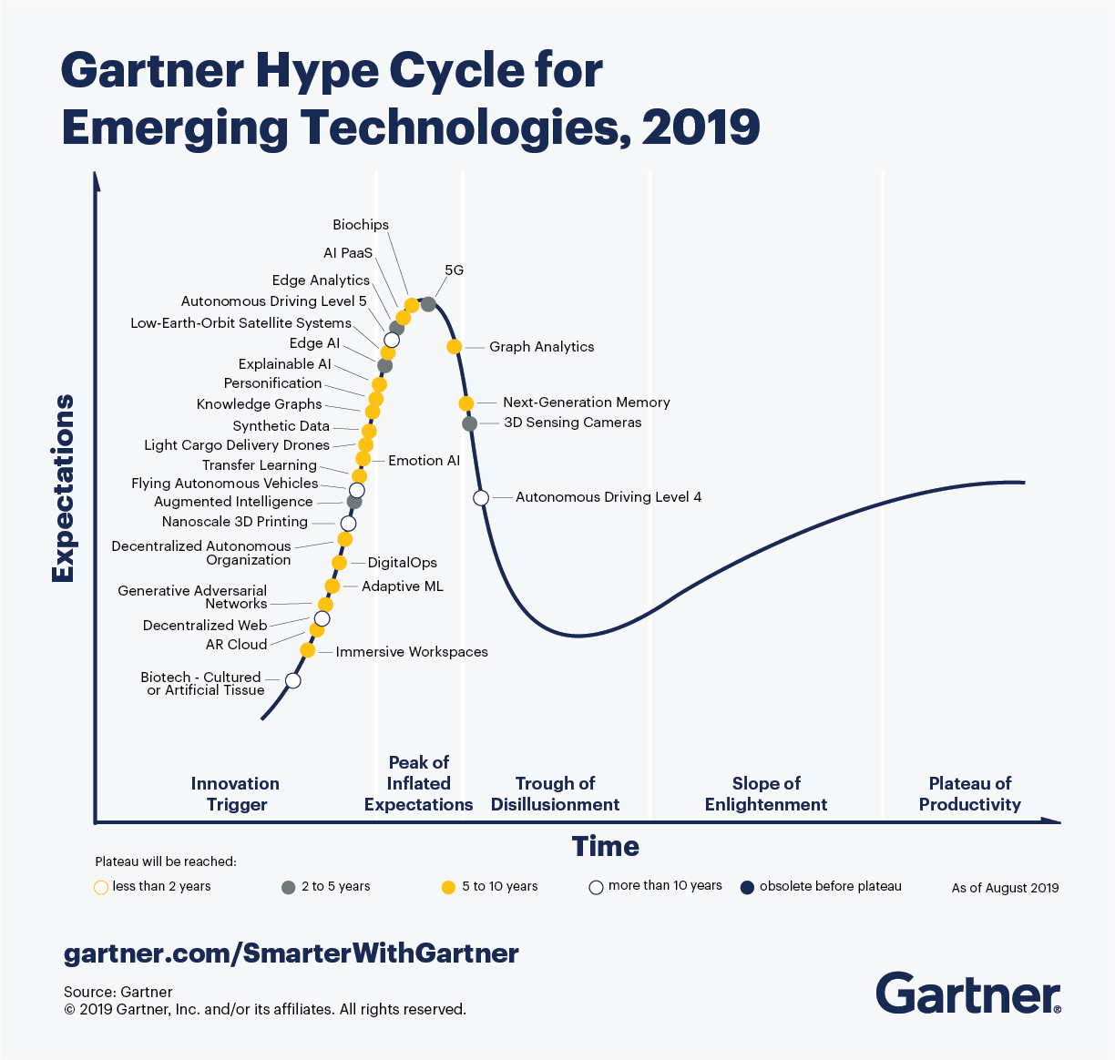
It is a part of hype cycle
Introduction
https://www.gartner.com/smarterwithgartner/5-trends-appear-on-the-gartner-hype-cycle-for-emerging-technologies-2019/

Slide 6
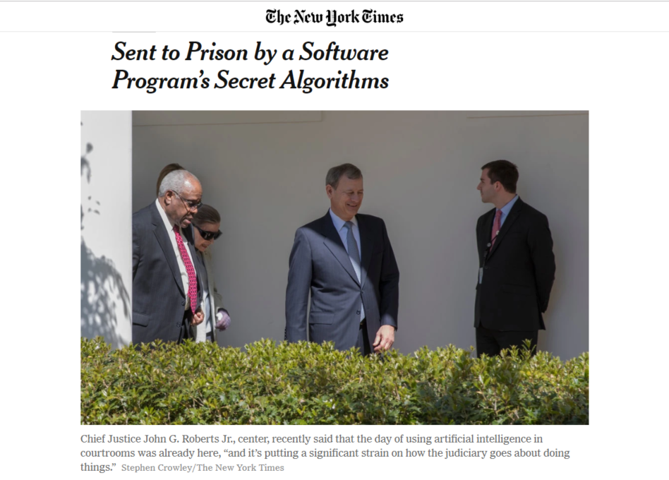
AI application for criminal justise
Introduction
Eric L. Loomis, who was sentenced to six years in prison based in part on a private company’s proprietary software. Mr. Loomis says his right to due process was violated by a judge’s consideration of a report generated by the software’s secret algorithm, one Mr. Loomis was unable to inspect or challenge.
https://www.propublica.org/article/machine-bias-risk-assessments-in-criminal-sentencing

Slide 7

AI application to public spending
Introduction
https://www.theverge.com/2018/3/21/17144260/healthcare-medicaid-algorithm-arkansas-cerebral-palsy

Slide 8
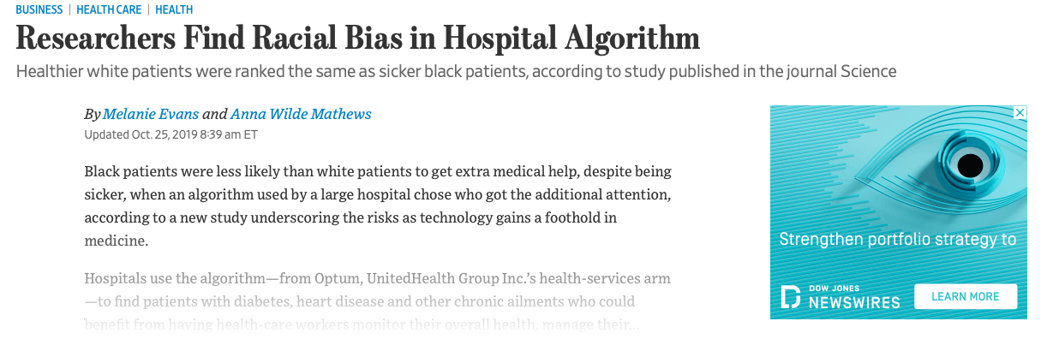
AI application for patient diagnostics
Introduction

Slide 9
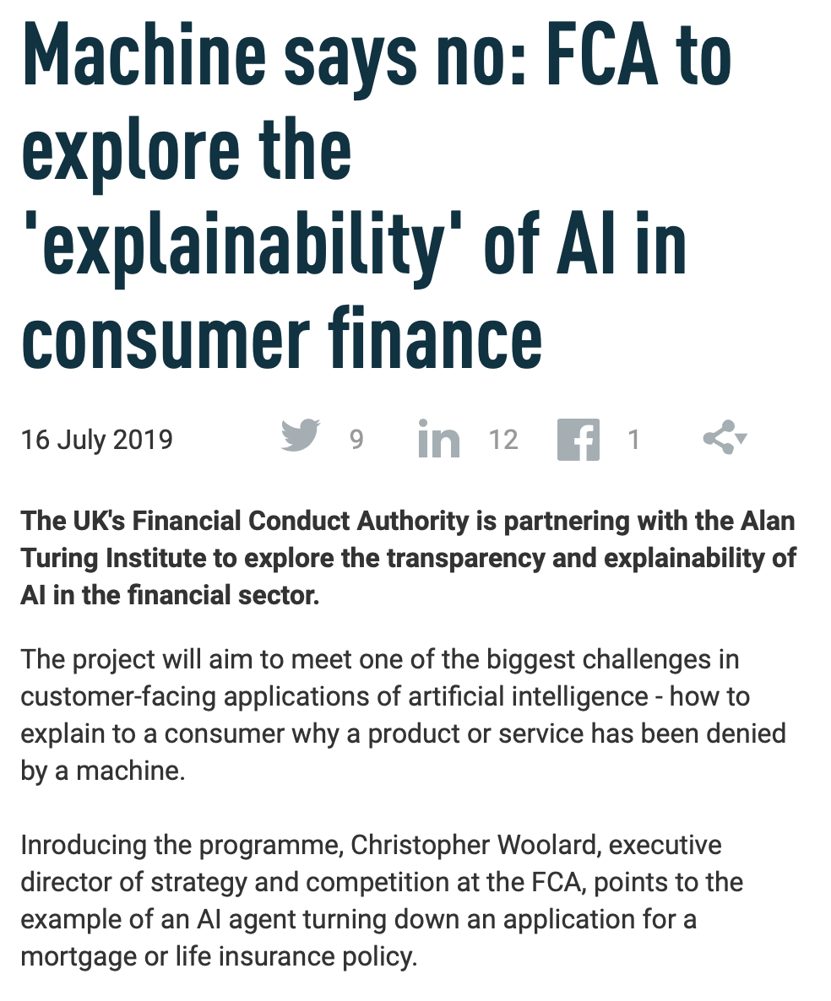
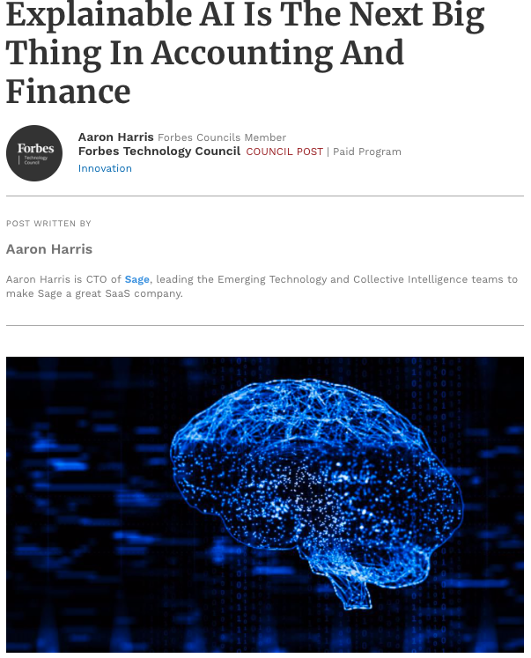
AI application for consumer finance
Introduction

Slide 10
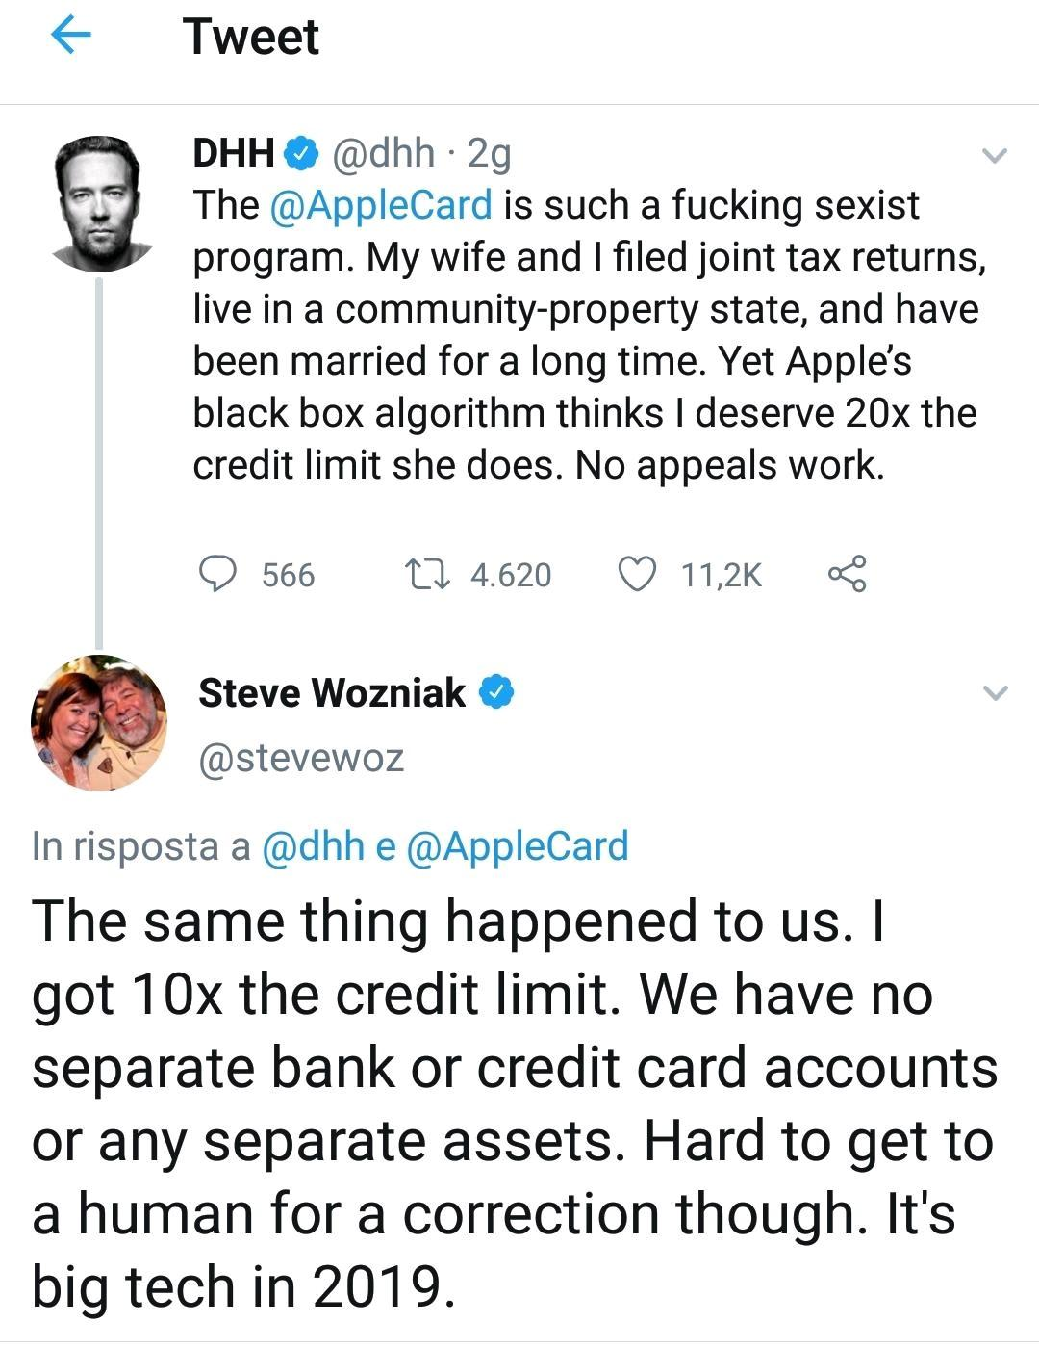
Just happened
Introduction

Slide 11
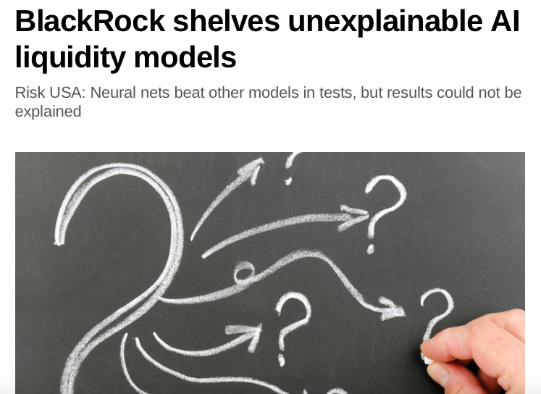
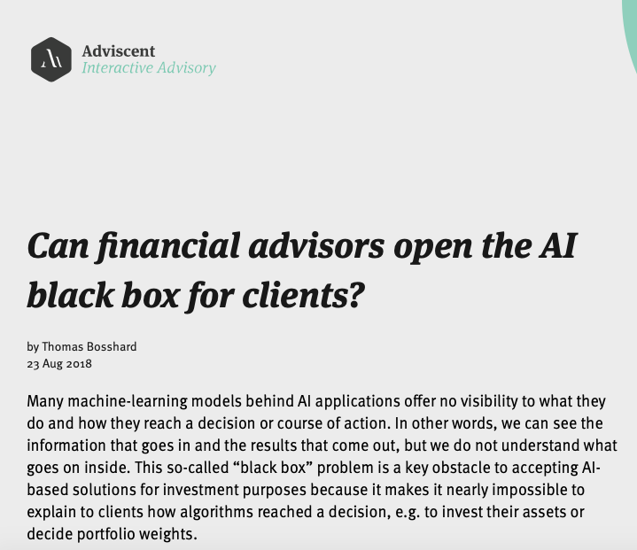
Application in FInance
Introduction

Slide 12
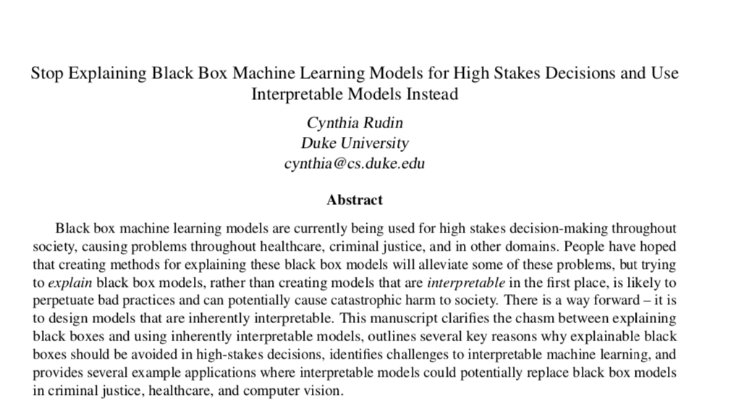
HIGH StAKEs decisions
Introduction

Slide 13
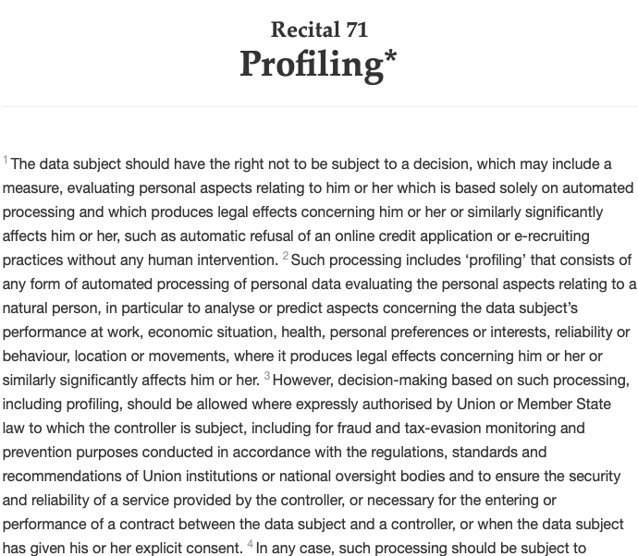
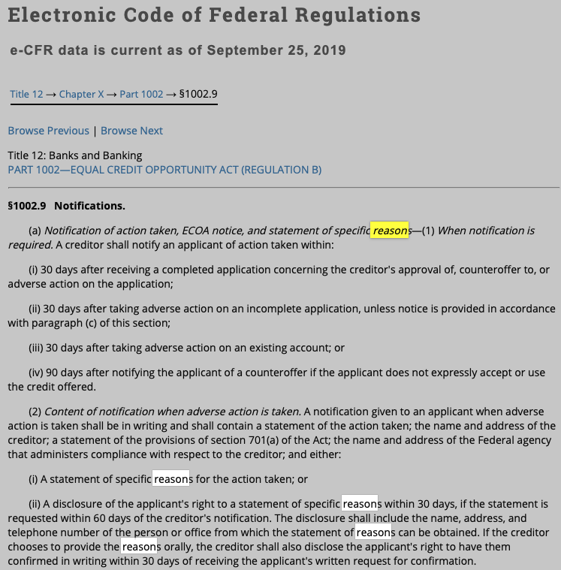
AI Regulation for finance (Eu AND USA)
Introduction

Slide 14
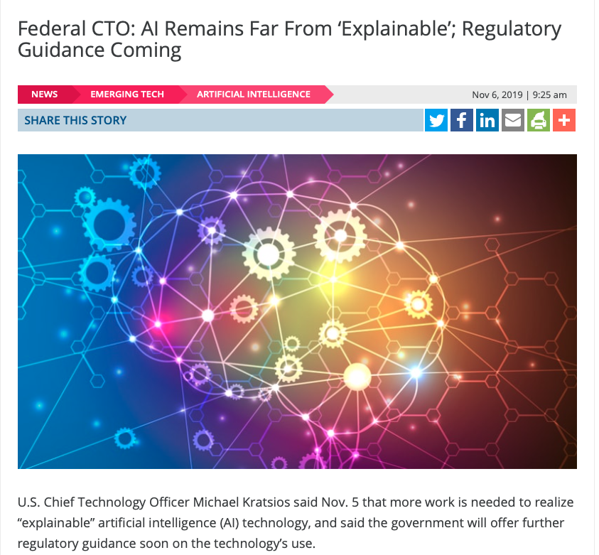
Regulation is coming
Introduction

Slide 15
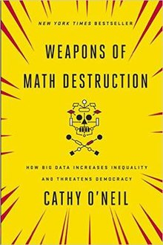
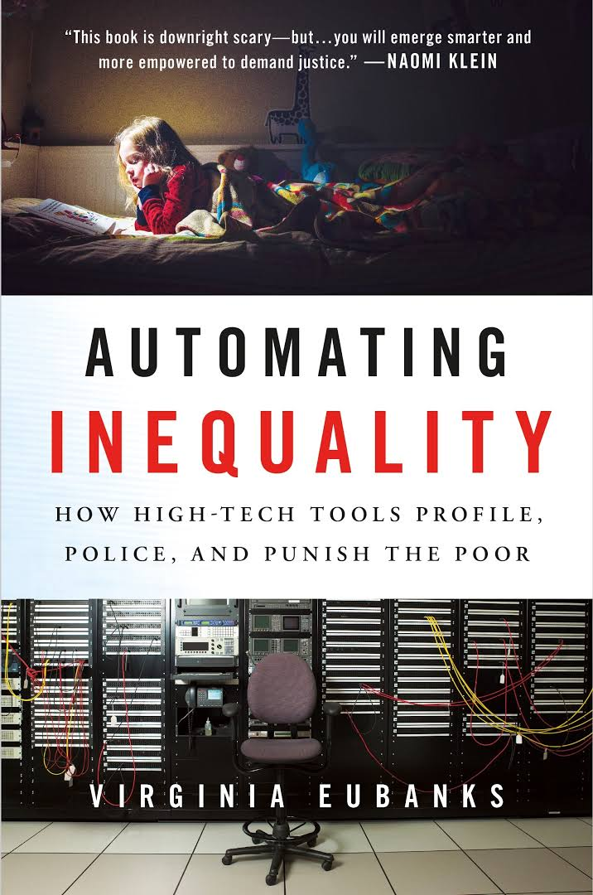
Books
Introduction

Slide 16
What is XAI?
Introduction
Explainable AI
XAI aims to produce "glass box" models that are explainable to a "human-in-the-loop", without greatly sacrificing AI performance.
Human users should be able to understand the AI's cognition (both in real-time and after the fact), and should be able to determine when to trust the AI and when the AI should be distrusted

Slide 17
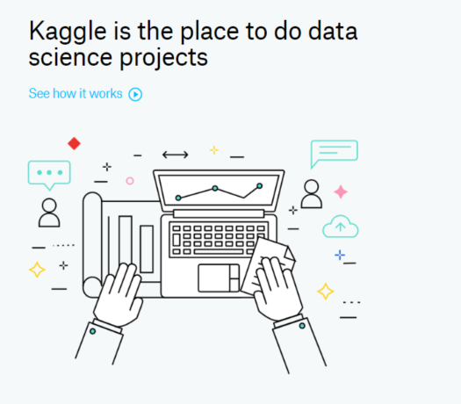
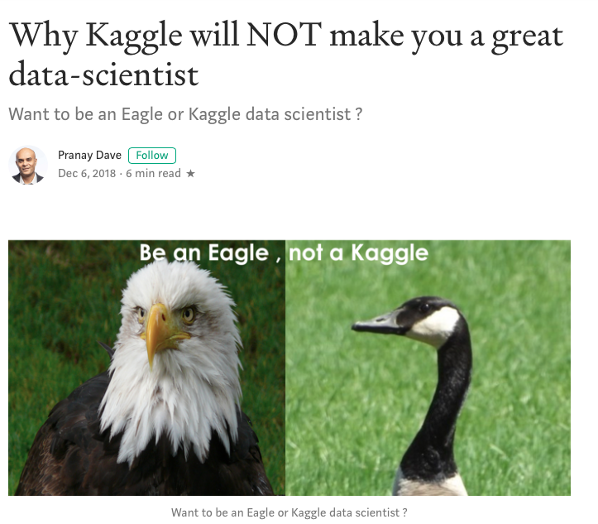
All attention was here
Introduction
AI competitions don’t produce useful models
https://lukeoakdenrayner.wordpress.com/2019/09/19/ai-competitions-dont-produce-useful-models/

Slide 18
What data scientists get wrong about XAI
Introduction
01
06
Judge AIs as alternatives rather than aides
Provide a single explanation for all audiences
02
07
Expect stakeholders to “think more like me”
Undervalue explanation friendly features
03
Optimize for model performance over enterprise utility
08
Fail to design for debugging
04
09
Assume rather than demonstrate generalizability
Value XAI only as a placebo
05
10
Believe what is said is what will be heard
Think moonshots are the model

Slide 19
Why we need XAI?
Introduction
01
Safety. We should build systems that make sound decisions.
02
Debugging. We should understand why a system does not work and how to fix it.
03
Science. We want to understand something new.
04
Mismatched Objectives. The system may not be optimized for the true objective.
05
Legal. Are we legally required to provided an explanation?

Slide 20
Emerging and existing approaches for tabular data
Emerging approaches
XAI
Glass-box models
Model explanation (global)
Post-hoc model explanations (local)
Linear regression
Logistic regression
Decision trees
Rule list
Rule sets
GAM
Etc.
Visualisation
Agnostic feature importance
Model surrogates
Local surrogate (LIME)
Local feature attribution (SHAP)
Local rule extraction (Anchor, LORE)
Contrastive explanations
Counterfactual explanations

Slide 21
Emerging and existing approaches for tabular data
Emerging approaches
XAI
Glass-box models
Model explanation (global)
Post-hoc model explanations (local)
Linear regression
Logistic regression
Decision trees
Rule list
Rule sets
GAM
Etc.
Visualisation
Agnostic feature importance
Model surrogates
Local surrogate (LIME)
Local feature attribution (SHAP)
Local rule extraction (Anchor, LORE)
Contrastive explanations
Counterfactual explanations

Slide 22
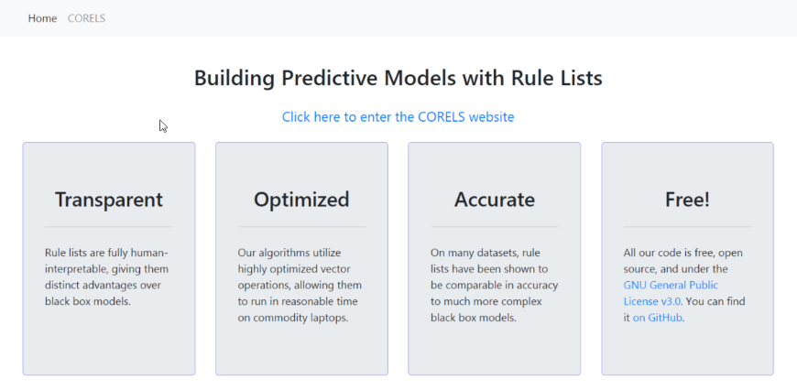
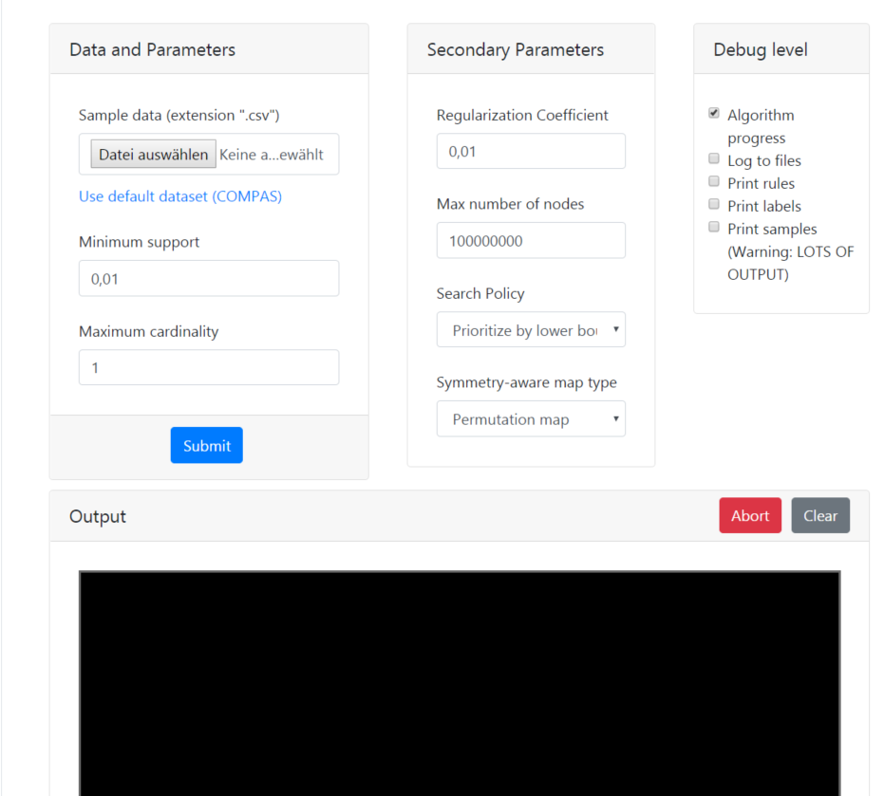
Try CORELS
https://corels.eecs.harvard.edu/corels/run.html

Slide 23
XAI in retail
Application to retail
XAI
Stakefolder management
Build user trust
Model debugging

Slide 24
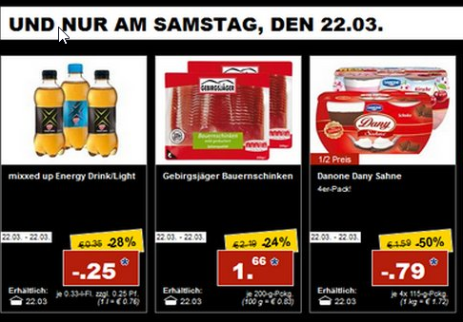

Consider a problem of promotion planning
Application in retail
Planners collect data on their own
Planners have to decide
what,
when,
under what conditions
How much
Experience generates rules

Slide 25
Consider a problem of promotion planning
Application in retail
AI
Counterintuitive results generate mistrust.
Users stop using and rely more on personal intuition.
Experience generates rules

Slide 26
Consider a problem of promotion planning
Application in retail
AI
1.80 < abs_price_diff < 3.11 AND 327.75 < avg_regular_sales < 662.83
expiration_days = 6 AND sale_length_clean = 3 AND 4689.8 < total_regular_revenue < 11219.6
OR
The model predicted 5.48 instead of more than 5.48 because abs_price_diff <= 1.796 and year > 2015
The model predicted 4.54 instead of more than 4.54 because total_regular_revenue > 6129.841 and sale_length > 6.463
Experience generates rules

Slide 27
Consider a problem of promotion planning
Application in retail
Original problem
Regression
Classification
Predict sales during promotions
Predict if sales uplift is greater or less than a median

Slide 28
EXAMPLE
Application in retail
We have to plan a new promotion and would like to see how effective it will be and Why.

Slide 29
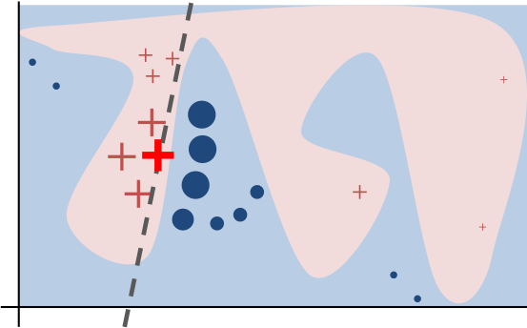
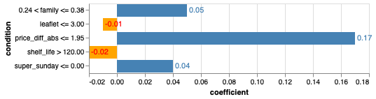
LIME
Emerging approaches
LIME is a local surrogate model
We pick some promotion to classify
The promotion was classified as being over the median
With score 0.96

Slide 30
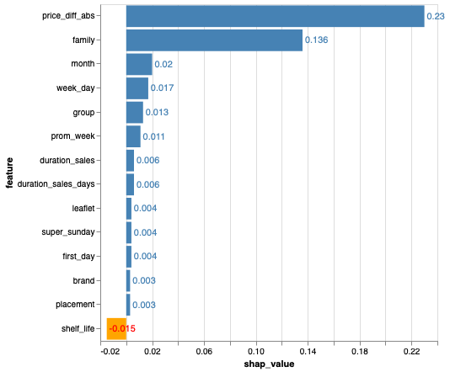
SHAP
Emerging approaches
SHAP value explains the contribution to explain the difference between the average model prediction and the actual prediction of the instance.

Slide 31
Anchor
Emerging approaches
Anchor – local rules with guarantees
price_diff_abs <= 2.00 AND family <= 0.38 AND placement > 0

Slide 32
Counterfactual explanations
Emerging approaches
What minimal changes do we need to introduce to flip the prediction
One can only allow changes to specific features (month, day, store location, etc.)
Sometimes it is not possible to find a counterfactual, especially when model score is close to 1.
A counterfactual:
family: change item family
group: change item group
price_diff_abs: decrease price by 2

Slide 33
Contrastive explanations
Emerging approaches
„Why P rather than Q?“
The model predicted '0' instead of '1' because 'price_diff_abs <= 2.934

Slide 34
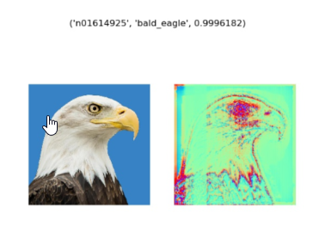
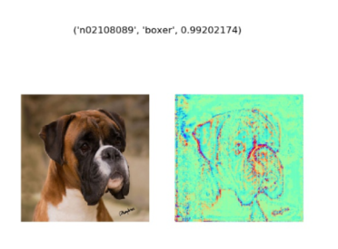
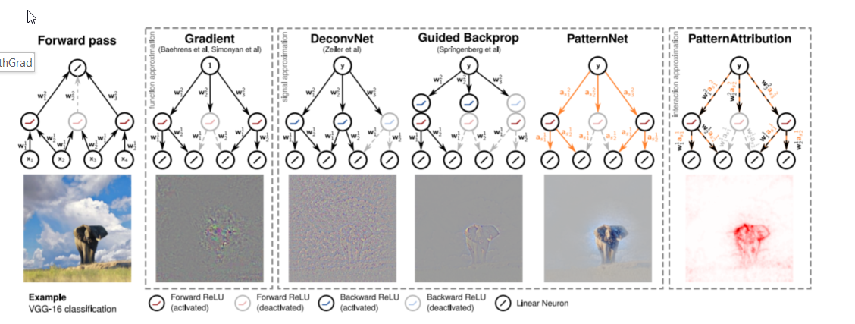
Xai for nlp and computer vision
Future prospects
Saliency maps
Layer-wise Relevance Propagation
Gradient based methods
TCAV
Etc.

Slide 35
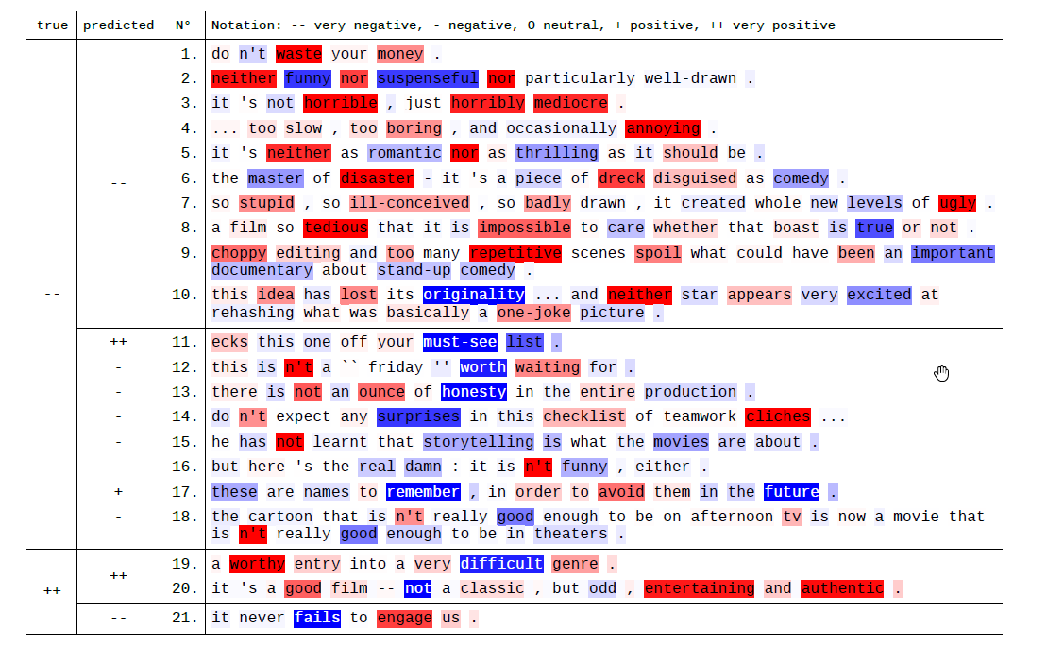
Xai for nlp and computer vision
Future prospects
Layer-wise Relevance Propagation (LRP)
Learning to explain (L2X)
SHAP
LIME
Etc.

Slide 36
JOIN the club
Collaborate
https://www.linkedin.com/groups/8672810/ - my LinkedIn group Explainable AI –XAI
https://github.com/andreysharapov/xaience - resources on XAI, fairness and more
https://www.xaience.eu/ - my webpage with services

Slide 37
I invite everyboby to collaborate in the field of explainable AI and algorithmic fairness
Thank you for the time you spend with me

